Slide 1
Yearend FUN!!!
With G & W Finance
Notes:
Thank you all for joining us today.
My name is Wendy Keller and helping with questions is Greg Lowry. Together we are known as G&W Finance. If you have questions, you are welcome to talk or if you are more comfortable you can address your questions directly to Greg in the CHAT. This way your questions won’t get lost among the chit chat that might go on. Saying hi to friends you haven’t seen for over a year ☺
Multiple people are not able to attend today, so I’ve been asked to record this meeting. Please don’t this stop you from asking questions.

Slide 2
Learning Objectives
Dates and Deadlines
Reclassifications & Expense Year
Accounts Receivable/Bad Debt
Year End Tasks
Updates and Reminders

Slide 3
Dates & Deadlines
July 10
Refresh 12:30 & 3:00 pm
July 22
Entries, Payroll,& Invs to AP
July 27
Approvals & AP Pymts End
Aug 2
June Final
Aug 9
July Month End
July 9
June Prelim
July 1
Reclass of expenses start
June 30
Deposits to Cashier by 2:00

Slide 4
Reclassified Expenses
Record expenses in correct fiscal year per GAAP
Expenses are reclassed every night July 1st to July 27th
**USU does not reclass Pcard transactions**
Service Dates then Invoice Dates
Banner Description = Reclassified L0123456 G&W Finance
Encumbrance dates DO NOT dictate the expense year

Slide 5
Service Invoices
Accounts Payable reviews all invoices with split year service dates.
If the invoice is received prior to June 30th, the expense is split between the old and new year.
If the invoice is received after June 30th, the expense will be recorded in the year where the majority of service was provided.

Slide 6
Product Invoices Received in New Year
For invoices received in old year with a new year date, invoice will be held by AP and entered and processed in new year.
For invoices received in new year and the invoice date is in old year, expense will be in new year and then reclassified back to old year.

Slide 7
Yearend Tasks
Submit all invoices to acctpay@usu.edu as soon as received, deadline is July 22nd
Settle all old year travel through ServiceNow by July 22nd. Do nothing June 30th 5:00 pm – July 1 8:00 a.m.
Annual leave used in June must be entered, posted, and approved by July 22nd
Reallocations, journal and budget entries, and OCE’s entered by July 22nd and approved by July 27th
Account code 715809 needs cleared out to revenue.
Notes:
Contact vendors for any outstanding invoices and submit them asap.
715809 – For those of you that may not know about this account code, I wanted to review what it’s used for.
EZ-Buy does not allow checks to be coded to revenue account codes., those that start with a 5. We created this expense code to use whenever revenue needs to be returned. It is a clearing account only.
After the expense is posted to an index, a journal entry has to be done to CR 715809 and DR the revenue account code. This account code needs to have a zero balance on every index for June 30.

Slide 8
What is Accounts Receivable?
Accounts Receivable is money owed for sales or services rendered in FY2021 that was not collected by June 30, 2021

Slide 9
Detailed List of Accounts Receivable
Index | Index Title | Fund | Revenue Acct Code | Date of Service | Vendor Name | Amount | Invoice Number
Notes:
Stacy Larmore will send out a template like this to collect the AR information.
This will need returned to Stacy by July 9th.
This needs to be in transactional detail. Do not lump one vendor together.

Slide 10
What is Bad Debt?
Bad Debt is money owed for sales or services rendered in FY2020 that HAS NOT been collected by June 30, 2021 and was recorded as accounts receivable in FY2020.

Slide 11
Detailed List of Bad Debt
Index | Index Title | Fund | Vendor Name | Date of Service | Amount | Invoice Number
Notes:
Stacy Larmore will be sending a separate template to fill out. Again, please list each transaction separately so we can check the list against last year’s accounts receivable. This will be due back to Stacy by July 9th.

Slide 12
June 30 5:00 p.m. to July 1 8:00 a.m.
Notes:
No EZ-Buy approvals
No travel activity in ServiceNow.

Slide 13
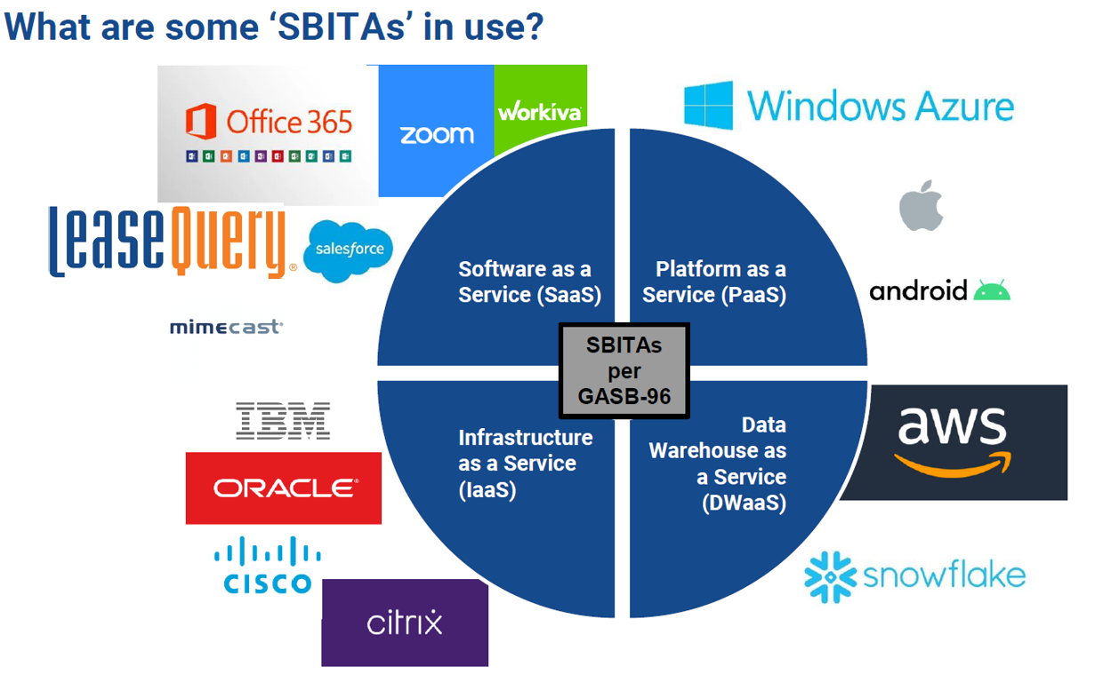
Subscription Based Information Technology Arrangements
(SBITA)
Definition:
A contract that conveys control of the right to use hardware, software, or a combination of both, including IT infrastructure, as specified in the contract for a period of time in and exchange or exchange-like transaction.
Notes:
SaaS – Software as a Service: Available as a 3rd party over the internet
PaaS-Platform as a Service: Hardware and software tools available over the internet
IaaS-Infrastructure as a Service: Cloud based service, pay as you go storage
DWaaS- Data Warehouse as a Service: Data storage, Data warehouse services with investing in a proprietary data warehouse solution, Server farming.
All of the above are referred to as Cloud based computing.
What do we need to do?
We are required to report a liability for all SBITA’s that are or could potentially be for more than 12 months.
An email was sent to the Financial Officers at the beginning of April requesting a list of existing SBITA’s.
If you have a new SBITA please send it through the contract review process with a software classification.

Slide 14
Not creating any more “C” indexes and “F” Funds
Will continue to set up “C” indexes on existing “F” funds when needed
Notes:
About a year ago, there were some reporting changes across all of the campuses. These changes created havoc with our index and fund code setups. C indexes and F funds no longer designate accounts that are specific to the Price or Blanding campus.
It was decided that no new C & F indexes and funds will be set up. We will continue to set up new C indexes if one is needed on an existing F fund, for example, the Tech Ed State Appropriation Line.
If we ever run out of A indexes and fund that start with 1, we can start using the C’s and F’s. Banner has been in place 16 years now and we still aren’t half way through the amount of A indexes available.

Slide 15
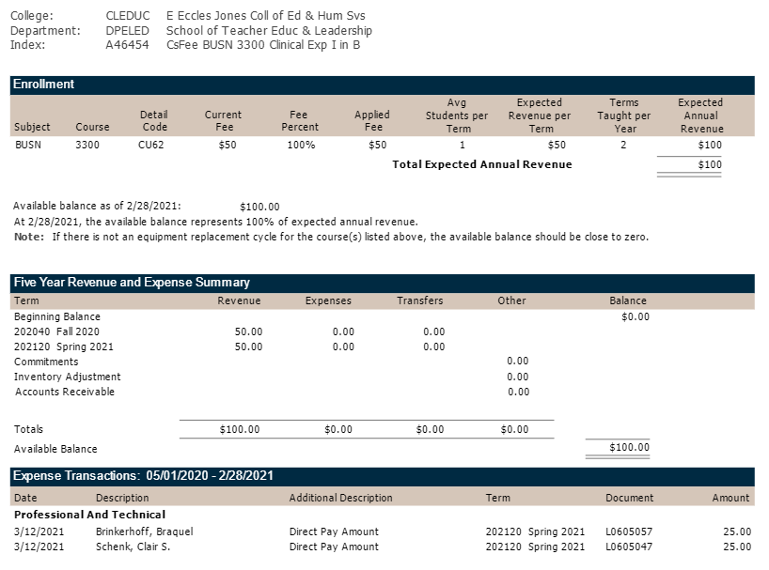
Notes:
Course Fee Summary Reports - Four plus year project finally ready for Bus. Services
Each college has a folder in Box. I made the FO’s the editor of their college’s folder so you can share the folder with whomever you need to.
Reports will run the day after each month end close and then I will load them into Box. The name of the file will have the fiscal year and fiscal period of the report.
Today I will put March reports in the folders and then April’s reports will be added on the 7th-8th working day in May.
The first section of the report shows the course and enrollment information and expected annual revenue. The next section is a rolling five-year look back at all revenue and expenses by semester, with the available balance as of that fiscal period.
The final section is a detailed list of all expenses from May 1 of the prior year to the end of this fiscal period.
We are working on a R&R process in ServiceNow so new indexes can be created, equipment lists can be updated, and the percentage split between the R&R and operating indexes can be changed. Reports for these R&R indexes are still being worked on.

Slide 16
Questions????

