Slide 1

Public Land Corps Hiring Authority

Slide 2
What is the PLCHA?
The Public Lands Corps Hiring Authority is a two year non-competitive hiring status for land management positions provided to eligible Public Land Corps participants.

Slide 3
What gives the PLCHA is legal authority?
Public Lands Corps Act of 1993
Public Land Corps Healthy Forest Restoration Act of 2005
National Park Service Centennial Act (2016)

Slide 4
Who is eligible for the PLCHA?
Any Conservation Corps member between the ages of 16-30
Completed a total 640 hours of appropriate conservation corps projects on public lands
120 hours must be completed on a certified public lands corps project (defined by the authority that governments your project agreement)

Slide 5
How a Member obtains a PLCHA status?
Complete at least 120 PLC hours within a SINGLE land agency – that is the agency that will certify your status
Hours are tracked in a form provided by the agency (on our website)
The other 520 hours can be on ANY project that falls under the definition of an appropriate conservation project.
The project partner verifies the tracking sheet at the end of each and every project
Members send completed form to the appropriate agency personel (on our website) -- Agency then verifies all hours and provides a certificate for the Corpsmembers
Non-competitive status lasts for two years from the date on the certificate (Most likely the last day of your last project)

Slide 6
EXAMPLE FORM:
The left image is a PLC project with the FS, this counts toward the 120 PLC hours. The right image is a non-PLC project, this project counts toward the remaining 540 hours.
Notes:
The left image is a PLC project with the FS, this counts toward the 120 PLC hours. The right image is a non-PLC project, this project counts toward the remaining 540 hours.

Slide 7
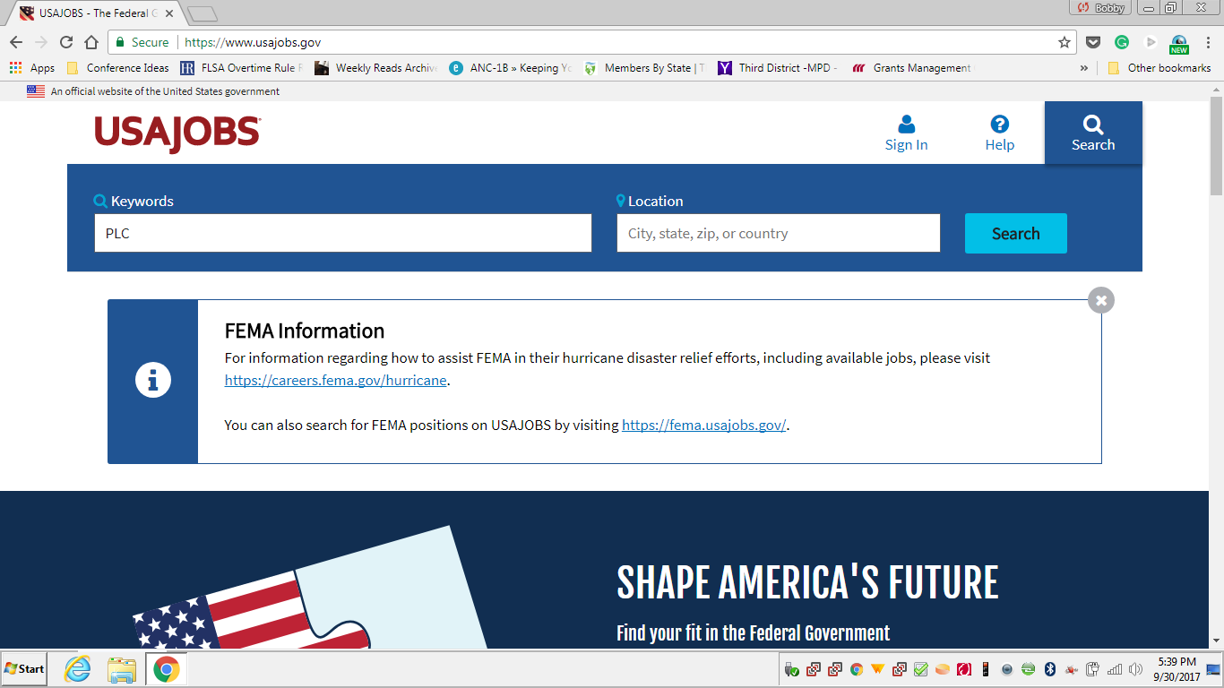

Slide 8
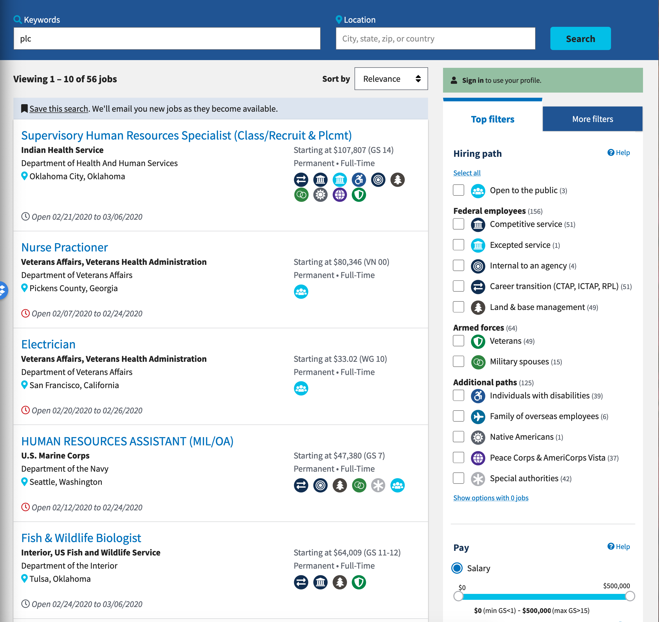
WHAT TO LOOK FOR ON USAJOBS.GOV
PLC Falls under “Special Authorities” on USAJOBS.GOV, but not all jobs in that category allow PLC, so be sure to read the individual job description

Slide 9
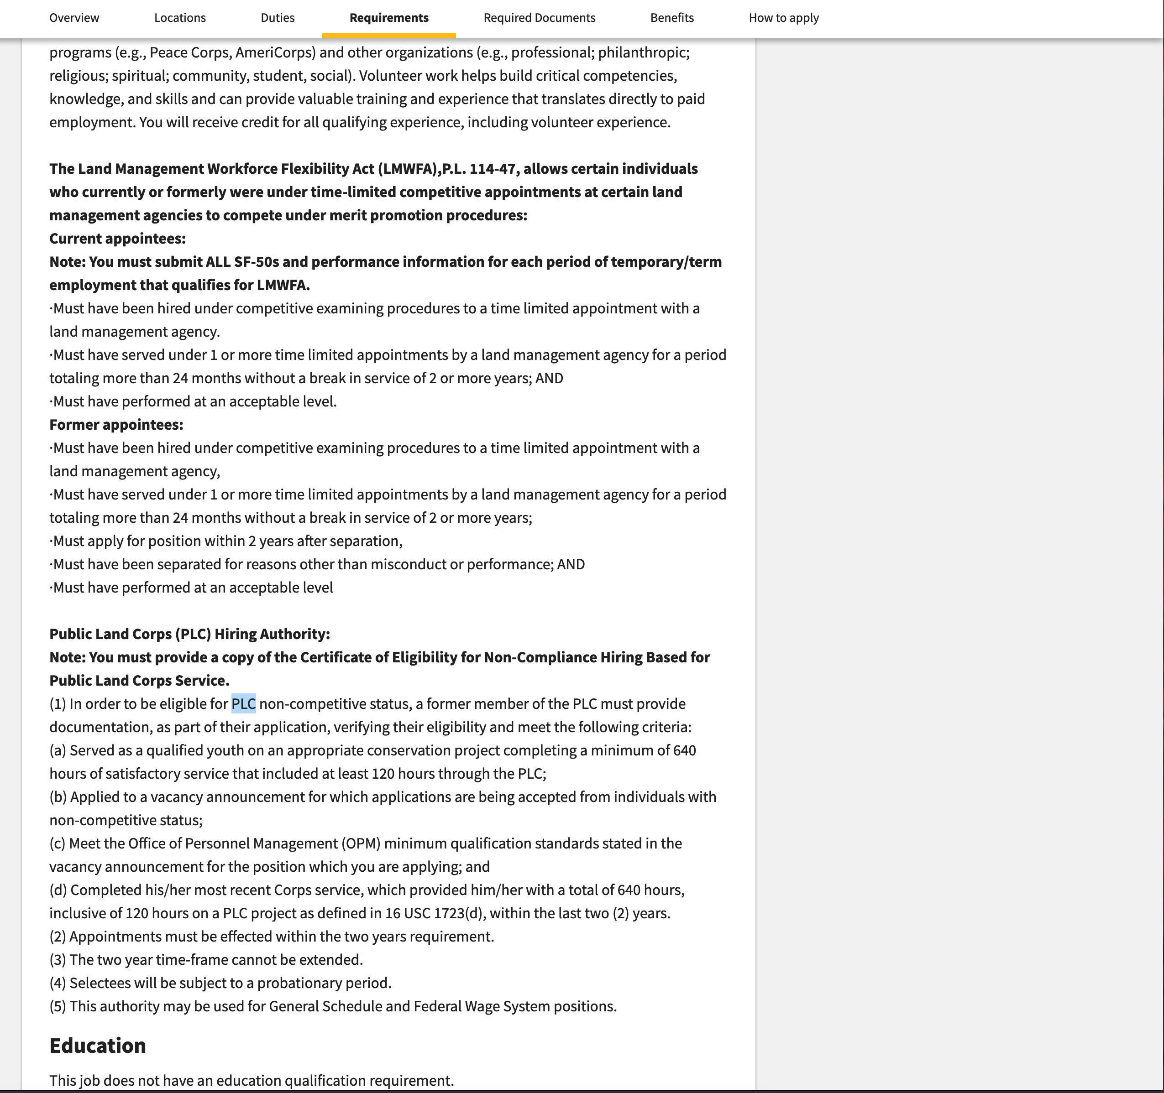
Search for PLC on the page to verify eligibility

Slide 10
Weird Stuff
Each Agency has a different process, only have known processes for NPS, FS and USFWS.
NPS says the cut-off date for using the authority is either your 31st birthday or the two year mark; USFS is only the two year mark

Slide 11
Using the PLCHA
Upload your completed certificate onto usajobs.gov
Keyword search for “PLC” to find positions that accept the PLCHA
Apply and include your certificate in the supporting documents

