Slide 1
Spring 2024 Captain’s Materials

Slide 2
Eligibility
USU students must be enrolled in at least one (1) fee-bearing credit
Current faculty or staff member with Campus Recreation Membership
Spouses of students can purchase a spouse pass ($40)
Spouses of faculty/staff must get permission for HR and purchase an ID Card

Slide 3
Eligibility
All players must bring either their USU ID or a valid driver’s license to all intramural games.
No ID, No Play
All players must purchase either the Intramural membership pass ($25) or the sport specific pass ($15)

Slide 4
Teams
Female identifying players may play on:
1 Women’s Team
1 Co-Rec Team
1 Open Team
Male identifying players may play on:
1 Men’s Team
1 Co-Rec Team
1 Open Team

Slide 5
Rosters
Professional athletes, current or former may not participate in their respective sport
Intercollegiate athletes are not eligible to participate in their respective intramural sport until a period of one year has passed following the completion of all activities for the department of athletics
No more than TWO (2) club sport athletes may participate for the same team in their respective intramural sport

Slide 6
Leagues/Gender Rules
Men’s League
Male identifying participants only. There may be a men’s competitive and men’s recreation division offered per sport if available
Women’s League
Female identifying participants only. There may be a women’s competitive and women’s recreation division offered per sport if available
Open Leagues
All genders without ratio requirements
Co-Rec Leagues
Slightly different rules for each sport. Will be a required amount of each gender to be eligible to play

Slide 7
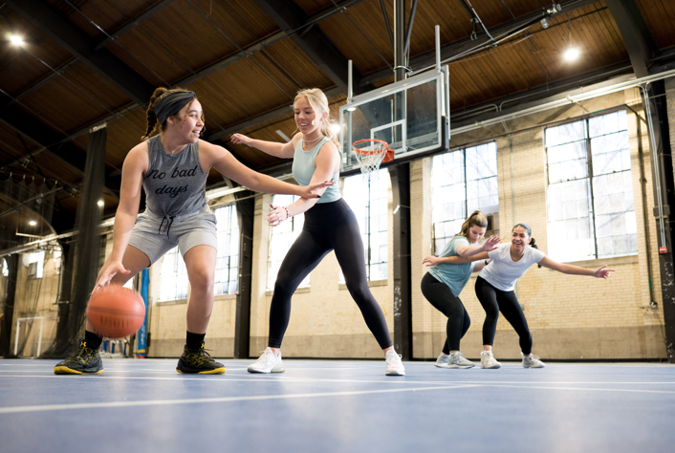
5v5 Basketball
Equipment
Athletic clothing is required
Please review sport specific rules on the website
Location
Games played in HPER and Fieldhouse
Gender Rules
Co-Rec
4 player minimum, at least 2 of each gender, +/- 1 ratio, Men sub for men, women sub for women
Open
Any combination of gender
4 player minimum
Men’s/Women’s
4 player minimum

Slide 8
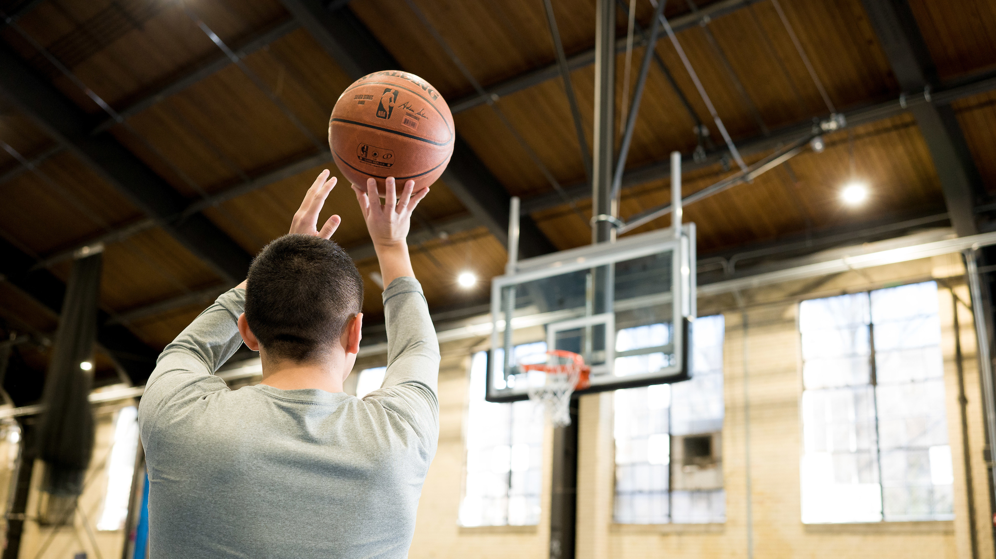
The season
The season will be 5 weeks long
Each team will have a bye week (4 scheduled games)

Slide 9
Rules Changes
Games will consist of four 10-minute quarters with a 30 second break in-between each quarter
This is a change from the past where games consisted of two 20-minute halves
There is no longer a 1-and-1 bonus at 7 team fouls or 2 shot bonus at 10 team fouls. Instead, at the 5th team foul and every foul after that (NOT including player control and team control fouls) in each quarter the other team will shoot a two bonus.
This is a change to mirror the NCAA rule for Women’s College Basketball and the NBA

Slide 10
Defaults/Forfeits
Any team knowing in advance they will not be able to play a regular game can default.
Requests to default must be emailed by noon the day of the game
This will result in a loss and a sportsman ship rating of 3.0.
There will be a 5-minute grace period for all games. Failure to arrive and check in before 5 minutes is declared as a forfeit
A forfeited game will be marked as a forfeit and the team will receive a 2.0 for sportsmanship rating.
The winning team who did not default/forfeit will receive a 4.0 sportsmanship rating and the contest will be marked as a win.
If your team forfeits twice without any communication you will be removed from the league.

Slide 11
Sportsmanship
4​ | Team members cooperate with and demonstrate good sportsmanship toward members of opposing teams, spectators, and ALL campus recreation staff.​
3​ | Team members verbally complain about some of the decisions made by the officials and/or show minor dissensions, which may or may not merit unsportsmanlike conduct penalty. Teams receiving one unsportsmanlike conduct penalty will receive no higher than a 3.0 rating. ​
2​ | Teams show verbal dissent toward officials/and or the opposing team throughout the game, which may or may not result in an unsportsmanlike conduct penalty. Teams receiving more than one unsportsmanlike conduct penalty will receive no higher than a 2.0 rating. ​
1​ | Team continually dissents the officials and/or the opposing team from the court/sidelines. Teams that have a player ejected will receive no higher than a 1.0 rating.​
0​ | Team is completely uncooperative; manager has no control over the team/spectators/self. Teams play with ineligible participants or withhold any information requested. Damage or destruction of any Campus Recreation facility/equipment. Physical violence.​
All teams are rated on a sportsmanship scale of 0-4
Sportsmanship can be found online in “Rankings”
Participants and spectators shall not commit acts of unsportsmanlike conduct
Any participant displaying unsportsmanlike conduct will be issued a warning or an ejection

Slide 12
Postseason
Teams must have and maintain a 3.0 or higher sportsmanship rating to be eligible for postseason play
Rosters are frozen at the end of the regular season. Players cannot be added to the team during the postseason.
A post season draft will take place on the Friday following the last regular season game at 12:00pm on Friday March 2nd
Teams must have a winning percentage of .500 to be eligible for playoffs

Slide 13
Contacts
For any questions or concerns, please contact the competitive sports staff
intramurals@usu.edu
Bailey Adams
Assistant Director of Intramurals & Youth Programs
bailey.daniel.adams@usu.edu

