Slide 1
Emergency Response Team Plan

Slide 2
Before Starting….
British Medical Journal
Complete the Emergency Response Team training/presentation
Download/Print the Emergency Response Plan Template
usu.edu/dps/emergency
Questions: emergencymanagement@usu.edu

Slide 3
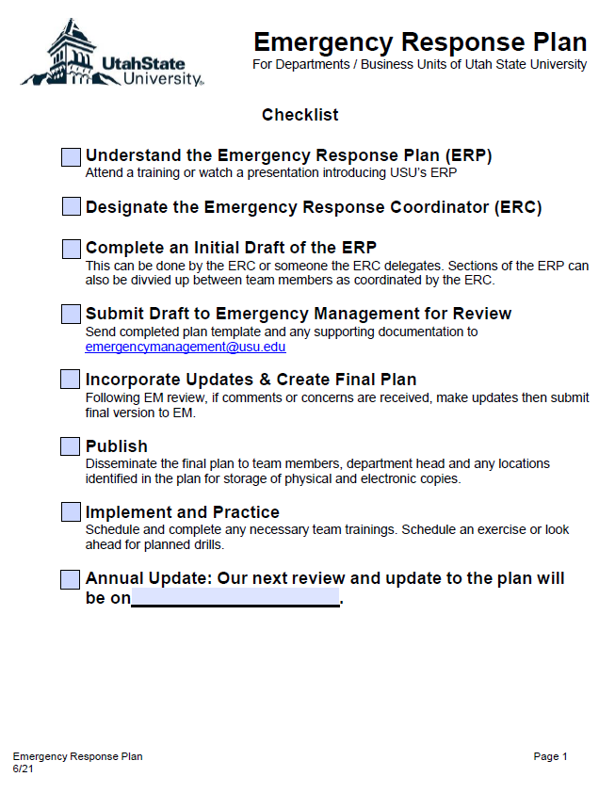
Check your plan date. Are you using an outdated version?
The most updated version is at:
https://www.usu.edu/dps/emergency/

Slide 4
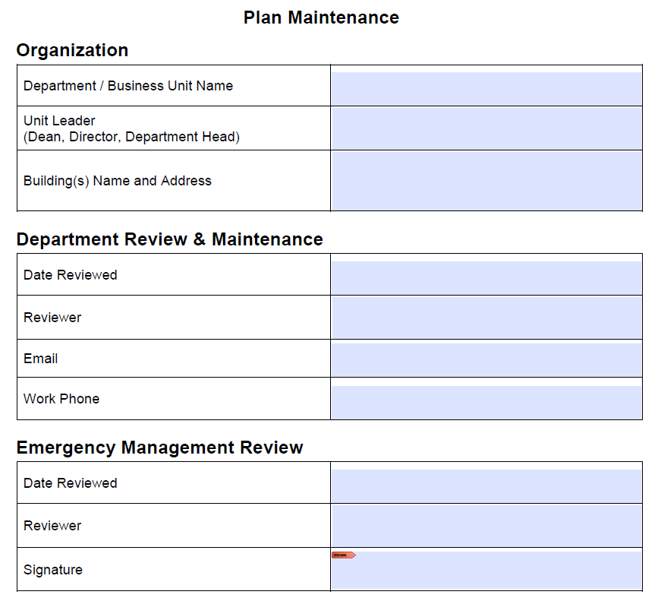
Aggie Ice Cream
Jane Smith
Creamery
750 N 1200 E, Logan, UT 84321
5/29/21
Mark Gibbons
Mark.gibbons@usu.edu
435-797-xxxx

Slide 5
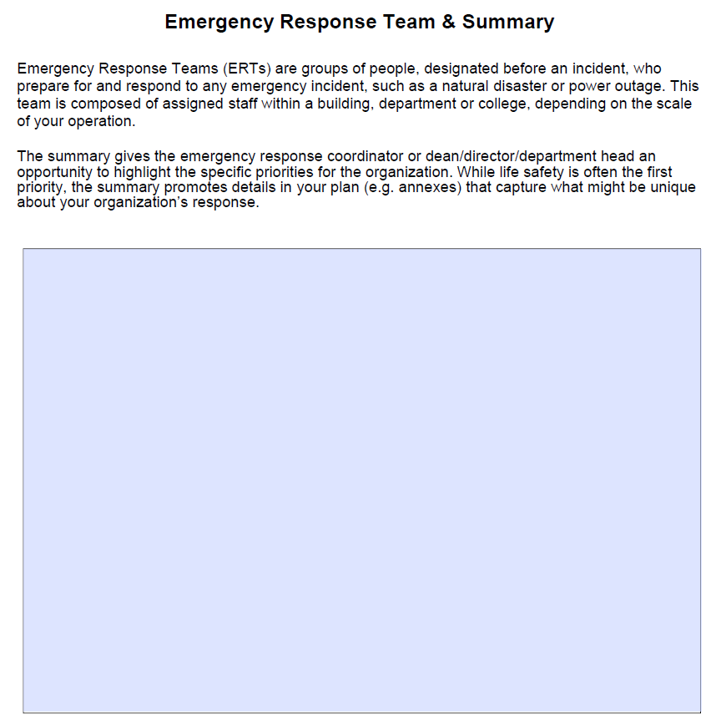
Aggie Ice Cream serves as both a campus learning center and retail shop open to the public.
Protecting staff, students, and visitors is our first priority. Property is also important – and our plans address how to protect our staff, students and visitors as well as preserve academic and retail property.
Since we are open to the public and also handle food, our staff engages in first aid, cpr, and food service training.

Slide 6
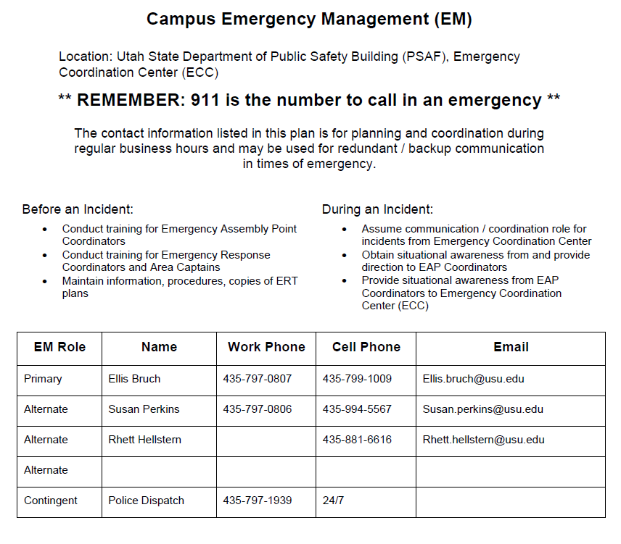

Slide 7
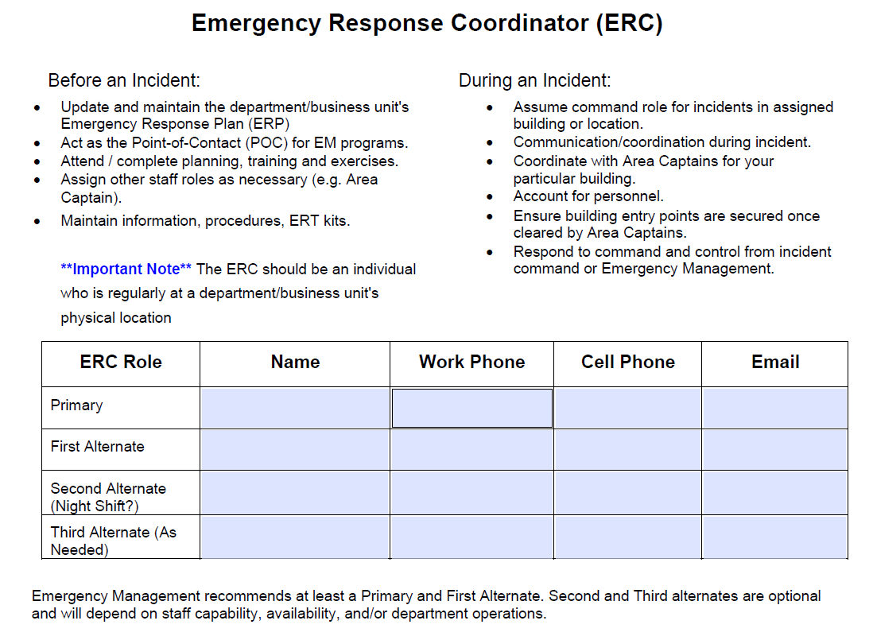
Mark Gibbons
@usu.edu
435-797-xxxx
435-xxx-xxxx
Kim Durbin
435-797-xxxx
435-xxx-xxxx
@usu.edu
Jake Ma
435-797-xxxx
435-xxx-xxxx
@usu.edu

Slide 8
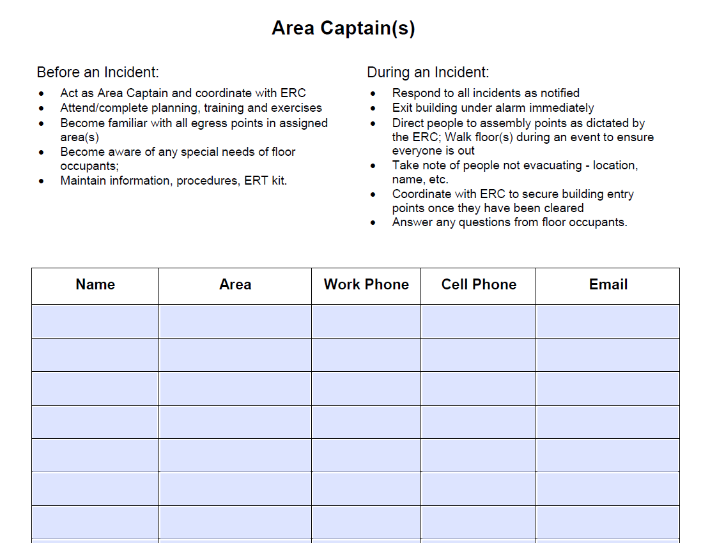
Jose Hernandez
1st Floor, South
435-797-xxxx
435-797-xxxx
@usu.edu
Meg Polczyk
1st Floor, North
435-797-xxxx
435-797-xxxx
@usu.edu
Grant Power
2nd Floor, North
435-797-xxxx
435-797-xxxx
@usu.edu
Lina Song
2nd Floor, South
435-797-xxxx
435-797-xxxx
@usu.edu

Slide 9
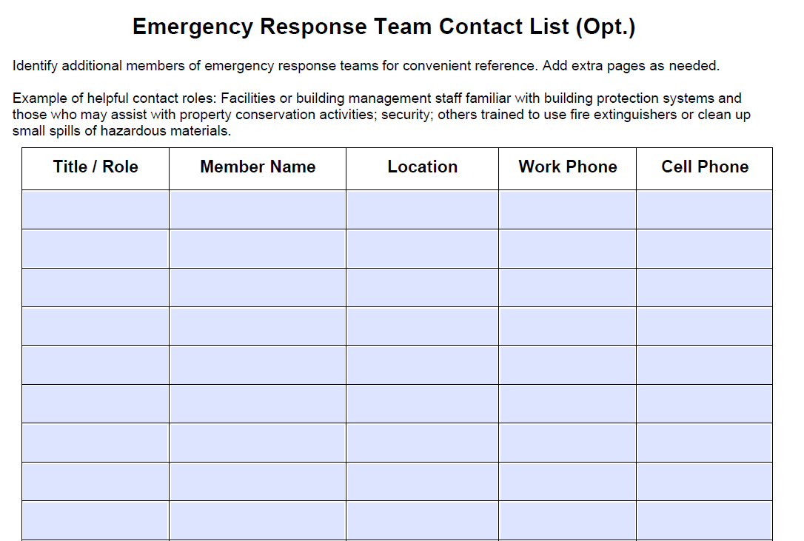
Emergency Sled Operator
Jilly Kryczek
4th Fl
435-797-xxxx
801-360-xxxx
Emergency Sled Operator
Wyatt DeGristina
5th Fl
435-797-xxxx
218-797-xxxx

Slide 10
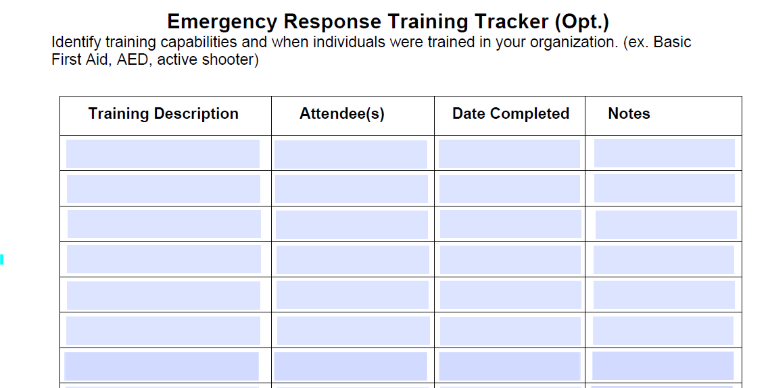
First Aid/CPR
Jilly Kryczek, Wyatt DeGristina
5/25/20
Good for 2 yrs
Active Shooter
Entire Department
6/19/2021
Absent: Marcus Alodi
ERT
Entire Department
7/14/2021

Slide 11
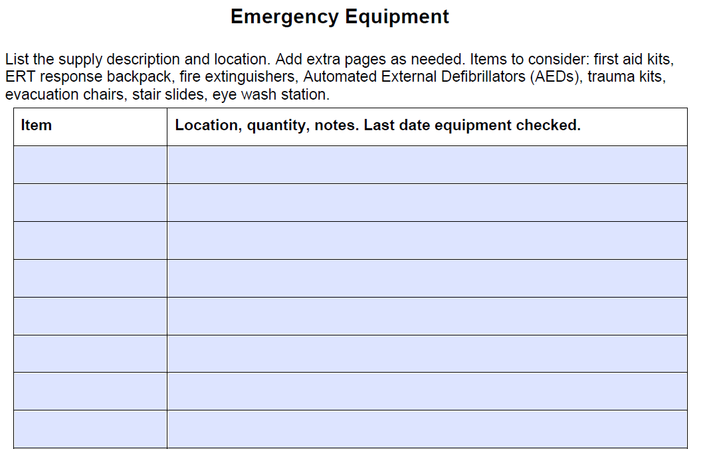
First Aid Kit
Room 202 – South side, next to admin desk. 4/21.
Evacuation Sled
4th Fl, north stairwell. 2/20.

Slide 12
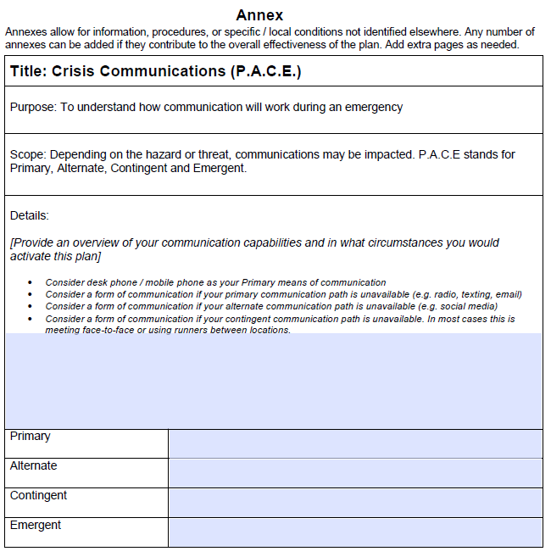
Cell Phone
Word of Mouth
Office Phone
Email

Slide 13
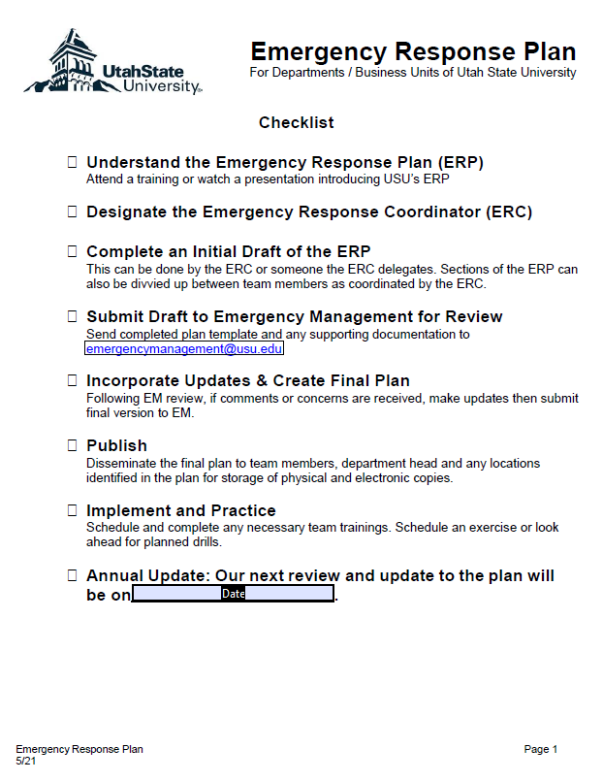
Review the Checklist

Slide 14
emergencymanagement@usu.edu

