Slide 1
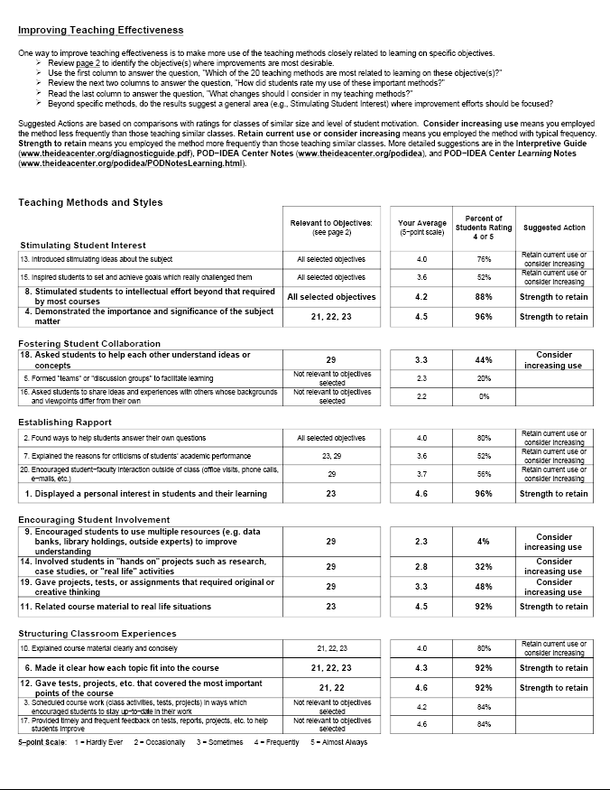
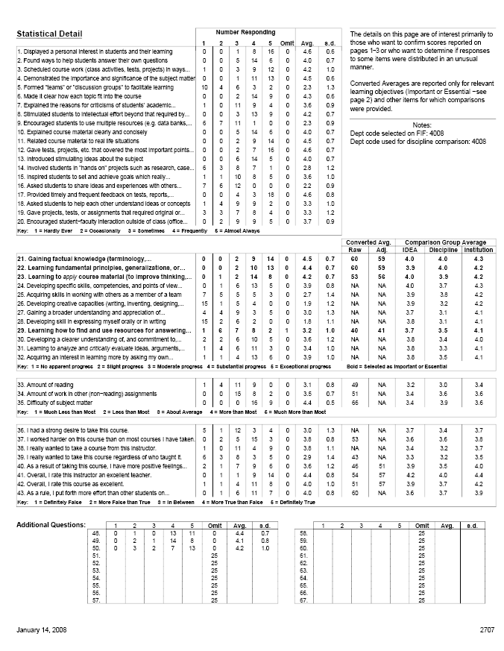
Interpreting IDEA Results:
Getting the Most from
Course Evaluations
Notes:
Formative Evaluation = Information for Faculty Improvement (what can I do better as an instructor)
There are two sumative questions that can be informed through the new IDEA course evaluation system:
How did the students in the class do? (achievement of learning objectives)
How did the instructor do?
Out discussion this morning will focus on the second question, specifically, the use of the IDEA results as a source of evidence in the USU Faculty Evaluation Process

Slide 2
Outline for Today
Overview: IDEA Results
Sample Size & Response Rate
Avg. Score vs. Converted Avg.
Understanding Learning Objectives
Raw Scores vs. Adjusted
IDEA’s use in Summative Evaluation
IDEA Results & Teaching Practice
Notes:
There are two questions that can be informed through the new IDEA course evaluation system:
How did the students in the class do (achievement of learning objectives)?
How did the instructor do?
Out discussion this morning will focus on the second question, specifically, the use of the IDEA results as a source of evidence in the USU Faculty Evaluation Process
The IDEA system, and student ratings in general, can have a positive impact if they are not overemphasized in the evaluation process. Because student ratings do not perfectly measure teaching effectiveness, using them for more than 30-50% of the overall evaluation of teaching can be seen as punitive. Using them appropriately will encourage faculty trust in the process, which will facilitate effective use of the information for teaching improvement.

Slide 3
Overview: IDEA Results
Reports will be mailed each semester
Results are also available online:
  http://usu.edu/aaa/evaluations_all.cfm
  You will need to log-in to view this page
Comments will be mailed/emailed, comments are not available online.
Frequently Asked Questions are here:
  http://usu.edu/aaa/idea_faculty_faq.cfm
Notes:
IDEA always ships paper reports (168 pounds last fall). We will forward these to the departments each semester, along with a copy of the “Departmental Summary.” Two copies of the printed report are supplied for each class, so there is a departmental hard copy if desired. Only a single printed copy of students comments is provided. My office keeps an electronic copy of all materials.
IDEA Results are available in a variety of formats online [show them the options by slowly walking them through the web pages]
Search box provides access to evaluation results for all types of evaluations (new = IDEA, old: paper-and-pencil, old: Blackboard/Canvas online).
You can search by faculty name (first, last, both); course name and/or number; term, year, or both; or any combination of the above
The summary list includes only a few fields (there are screen limitations) These could be modified.
Clicking on an entry in the list opens a new view, with much more detail [show them]
From the detail view, you can directly access the full .pdf of the report
These new IDEA .pdf files are also available in a searchable list: http://usu.edu/aaa/idea_results_frame.cfm
Comments will not be posted online, but one printed copy will be mailed, and an electronic copy will be emailed
Each department has (at least) one staff person trained on the IDEA system, and they will be copied on all mails and emails relating to IDEA

Slide 4
Sample Size/Response Rate
Notes:
SHOULD WE EVEN BE EVALUATING CLASSES WITH ENROLLMENT OF 5 STUDENTS OR LESS? [Discuss]
Large class sizes yield greater reliability (consistency). Response rate affects how representative your results are. The number of student respondents affects reliability. In this context, reliability refers to consistency, interrater reliability. Fewer than ten students are unreliable—evaluators should pay scant attention to numerical data from classes with fewer than ten respondents. IDEA reports the following median rates:
10 raters .69 reliability
15 raters .83 reliability
20 raters .83 reliability
30 raters .88 reliability
40 raters .91 reliability
Reliability ratings below .70 are highly suspect.
Response Rates at USU for Fall 2011:
Total Response Rate: Logan Campus 73.2% (Avg. of Avgs.) 70.4% (Total Responses/Total Enrollment)
Total Response Rate: RCDE 60.9% (Avg. of Avgs.) 60.4% (Total Responses/Total Enrollment)
Total Response Rate: USUE 36.0% (Avg. of Avgs.) 37.3% (Total Responses/Total Enrollment)
Total Response Rate: Logan + RCDE 70.1% (Avg. Of Avgs.) 68.3% (Total Responses/Total Enrollment)
Total Response Rate: ALL (including USUE) 65.0% (Avg. of Avgs.) 65.8% (Total Responses/Total Enrollment)
Top Five Departments (based on Total Responses/Total Enrollment):
Biological Engineering 90.9% 84.4%
Accounting 83.9% 84.1%
Special Education & Rehabilitation 88.3% 83.6%
Civil & Environmental Engineering 85.6% 83.2%
Nutrition, Dietetics & Food Science 80.1% 80.4%
Sixteen departments achieved response rates of 75% or better (Total Responses/Total Enrollment). Forty “departments” (including Honors as a department) achieved response rates of 65% or better (Total Responses/Total Enrollment).
In summary: USUE is going to need quite a bit of additional work, but we’re looking pretty good (on average) for Logan and RCDE.

Slide 5
Questions & Discussion

Slide 6
Avg. Score vs Converted Avg.
Notes:
Left Hand Side = Average Scores (Scale = 1-5) Used for “Criterion Reference” administrative evaluation
Right Hand Side = Converted Average Scores, or “T Scores.” Scale is 20-80, with 50 as the mean (average)
“USU has historically used a comparative process”

Slide 7
Converted Average (T Score)
Compares Your score to the average score of a normative group
  Standardizes scores with different averages and standard deviations
  Average = 50 Std. Deviation = 10
4.2+3.7+2.5+4.7+3.4+4.1+4.0+3.7+4.3+2.7+3.5+3.1+4.3+4.2+4.1+4.6+3.9+4.6+4.1+4.2+4.4+4.1+3.8+3.9+4.0+4.3+3.6+4.1+3.6+4.3+2.7+3.9+4.0+4.2+4.8+2.9+3.1+4.6+4.0+3.1 / 40 4.0 (Avg) = 50
4.1 (Avg) = 50
4.2
= 54
= 52
Notes:
Walk them through the converted average. Large rectangle is “IDEA Database.” Smaller rectangle is “Discipline Database.” Note different mid-point/average, and impact on the T Score

Slide 8
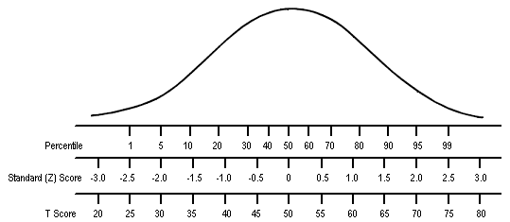
Converted Average
Notes:
Walk through the animation and describe

Slide 9
Questions & Discussion

Slide 10
Learning Objectives
Notes:
NA -- can’t combine those average scores because each item has a different mean and standard deviation.
Adjustments - even the playing field - which does mean the you can have a lower score - especially in small classes, highly motivated students.
It is clear from this table that “Work Habits” (WH, mean of Item 43) was generally the most potent predictor, followed by “Course Motivation” (CM, mean of Item 39). Classes that contained students who typically worked hard on their studies and/or were highly motivated to take the course regardless of who taught it were expected to receive favorable ratings; unless ratings were adjusted, the instructors of such classes would have an unfair advantage over colleagues with less motivated and dedicated students.
The regression coefficient for “Enrollment” (N) was not always statistically significant; but when it was, it was always negative. The larger the class, the lower the predicted (expected) rating. Those teaching small classes have an advantage over those teaching large classes; hence, in the interest of fairness, ratings should be adjusted to take this into account.
Except for the first two criterion ratings, the regression coefficient for D_{N} was always negative. Generally, if the discipline was perceived as difficult (after taking into account the impact of the instructor on perceived difficulty), an attenuated outcome can be expected. This was especially apparent in progress ratings on “Creative capacities” and “Communication skills” where high difficulty was strongly associated with low progress ratings. The two exceptions, where “disciplinary difficulty” had a positive effect on the predicted outcome, were for the progress ratings concerned with basic cognitive development (“Factual knowledge” and “Principles and theories”). In these instances, conventional wisdom (high difficulty = low ratings) was solidly refuted.
In most cases, student effort in the class (adjusted for the instructor’s influence on effort) was also negatively related to predicted ratings. Classes containing an unusually large number of students who worked harder than the instructor’s approach required ended up with lower progress ratings. The reason for this is unclear. Perhaps those who found it necessary to put in extra effort were those whose backgrounds did not prepare them well for the class. They may also be students who lack self-confidence and, for this reason, under-achieve (or under-estimate their progress in a self-abasing manner).
Decide which of 4 areas is most important - if #1, need to stress careful selection of the objectives

Slide 11
Pg 2: Progress on Objectives
4.5+4.5
4.4+4.4
4.2+4.2
+3.2
7
Notes:
The 5-point averages of progress ratings on “Essential” or “Important” objectives vary across objective. For instance, the average for “gaining factual knowledge” is 4.00, while that for “gaining a broader understanding and appreciation for intellectual/cultural activity is 3.69.
Essential weighted twice, important weighted once.
Questions:
On which objectives are students reporting the most progress?
Which objectives might this instructor want to think about and why?
What objectives are students reporting the most progress?
What objectives might this instructor want to think about and why?
Now…look at your own report and answer those two questions.

Slide 12
Too Many Objectives
Select only 3 to 5 Objectives
When selected from the list of 12 Learning Objectives, both Important & Essential count
Fall 2011: 145 Courses with all 12 learning objectives selected
Notes:
More than 800 classes had more than five learning objectives selected as either “Important,” or “Essential.”

Slide 13
Statistical Detail

Slide 14
Questions & Discussion

Slide 15
What is “Summary Evaluation”
Default Weights
50%
25%
25%

Slide 16
IDEA: Adjusted Scores
Notes:
NA -- can’t combine those average scores because each item has a different mean and standard deviation. Converted scores are T-scores (Mean = 50, SD = 10).
Adjustments - even the playing field - which does mean the you can have a lower score - especially in small classes, highly motivated students.
It is clear from this table that “Work Habits” (WH, mean of Item 43) was generally the most potent predictor, followed by “Course Motivation” (CM, mean of Item 39). Classes that contained students who typically worked hard on their studies and/or were highly motivated to take the course regardless of who taught it were expected to receive favorable ratings; unless ratings were adjusted, the instructors of such classes would have an unfair advantage over colleagues with less motivated and dedicated students.
The regression coefficient for “Enrollment” (N) was not always statistically significant; but when it was, it was always negative. The larger the class, the lower the predicted (expected) rating. Those teaching small classes have an advantage over those teaching large classes; hence, in the interest of fairness, ratings should be adjusted to take this into account.
Except for the first two criterion ratings, the regression coefficient for D_{N} was always negative. Generally, if the discipline was perceived as difficult (after taking into account the impact of the instructor on perceived difficulty), an attenuated outcome can be expected. This was especially apparent in progress ratings on “Creative capacities” and “Communication skills” where high difficulty was strongly associated with low progress ratings. The two exceptions, where “disciplinary difficulty” had a positive effect on the predicted outcome, were for the progress ratings concerned with basic cognitive development (“Factual knowledge” and “Principles and theories”). In these instances, conventional wisdom (high difficulty = low ratings) was solidly refuted.
In most cases, student effort in the class (adjusted for the instructor’s influence on effort) was also negatively related to predicted ratings. Classes containing an unusually large number of students who worked harder than the instructor’s approach required ended up with lower progress ratings. The reason for this is unclear. Perhaps those who found it necessary to put in extra effort were those whose backgrounds did not prepare them well for the class. They may also be students who lack self-confidence and, for this reason, under-achieve (or under-estimate their progress in a self-abasing manner).
Decide which of 4 areas is most important - if #1, need to stress careful selection of the objectives

Slide 17
Impact of Extraneous Factors
Gaining Factual Knowledge – Average Progress Ratings
Work Habits
(Item 43)
Student Motivation (Item 39)
High
High
Avg.
Avg.
Low
Avg.
Low
High
4.48
4.38
4.28
4.13
4.04
High Avg.
4.38
4.29
4.14
3.96
3.76
Average
4.28
4.14
4.01
3.83
3.64
Low Avg.
4.15
4.05
3.88
3.70
3.51
Technical
Report 12,
page 40
Low
4.11
3.96
3.78
3.58
3.38

Slide 18
Understanding Adjusted Scores
Notes:
This class has average lower motivation to take course and higher typical effort (self-perceptions).

Slide 19
When to Use Adjusted Scores
What is
the focus?
Instructor
contributions
Student
outcomes
  Are
  adjusted
scores lower or
higher than
unadjusted
scores?
Do
unadjusted (raw)
scores meet or
exceed ex-
pectations?*
Lower
Yes
Higher
No
Use
adjusted
scores
Use
unadjusted
(raw) scores
*Expectations defined
by your unit.

Slide 20
Adjusted or Unadjusted Scores What Should be Used?
Did faculty meet expectations for effective teaching based on raw scores OR adjusted scores?
Adjusted ratings – special consideration
  If unadjusted ratings “meet expectations,” and adjusted ratings are lower, use unadjusted scores
    Cutoff determined by each institution
    Don’t want to penalize a faculty member for having highly motivated students with good work habits
Notes:
If you choose to use adjusted scores, there is one situation that merits special consideration. If you have a class whose raw scores are above 4.0 or 4.2, and their adjusted scores are lower, we recommend that you consider using the unadjusted scores. In these cases, the lower adjustments are typically due to classes with students who are motivated to take them and have good work habits. Instructors typically cannot select the students enrolling in their courses and you probably don’t want to penalize them for this. Your campus needs to determine the specific cut-off scores, but this is an important consideration.

Slide 21
Questions & Discussion

Slide 22
IDEA Recommendations for Administrative Use of Scores
Results are not over-interpreted
  3-5 categories (Similar, Lower, Higher, Much Lower, Much Higher)
Review a “set” of data (6-8 classes)
  More data if small samples (n<10)
IDEA recommends that evaluation scores be used for no more than 30%-50% of summative evaluation
Notes:
The IDEA system, and student ratings in general, can have a positive impact if they are not overemphasized in the evaluation process. Because student ratings do not perfectly measure teaching effectiveness, using them for more than 30-50% of the overall evaluation of teaching can be seen as punitive. Using them appropriately will encourage faculty trust in the process, which will facilitate effective use of the information for teaching improvement.

Slide 23
Questions & Discussion

Slide 24
Reflective Practice with IDEA
Collect
Feedback
Interpret
Results
Read &
Learn
Reflect &
Discuss
Improve
IDEA
Student Performance
Peers/Mentors
Other Sources
IDEA Knowledge Center
POD-IDEA Center Notes
IDEA Papers
Other Resources

Slide 25
IDEA: Diagnostic

Slide 26
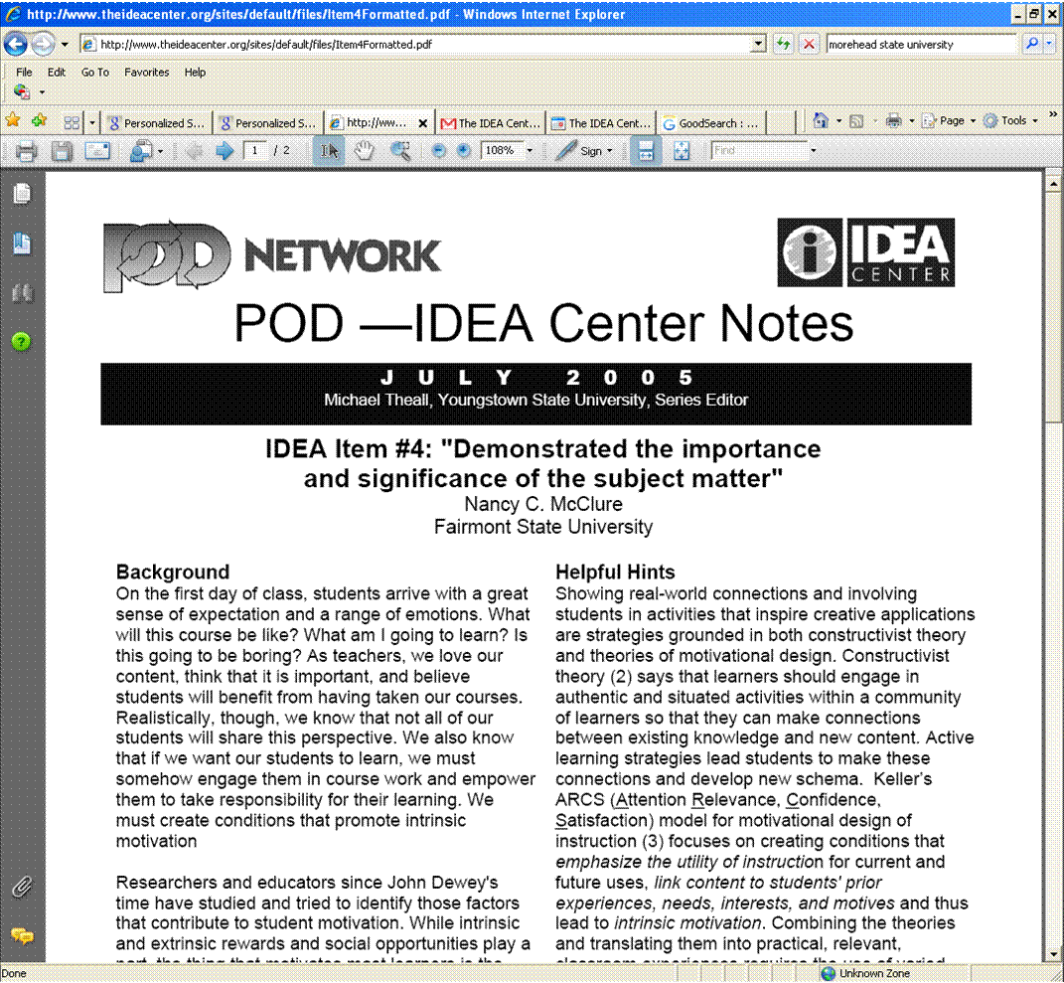

Slide 27
Final Discussion

