Slide 1
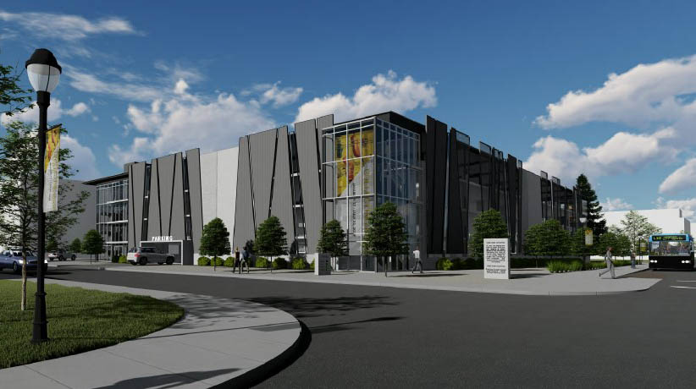
Parking & Transportation Advisory Committee
February 8, 2022

Slide 2
Welcome!
As a member of the Parking & Transportation Advisory Committee, you will be provided with information for the upcoming year. Please read all the material and be prepared to vote on Resolution 22-01 on February 8th, 2:00 PM, University Inn room 507.
If you have questions regarding any of the material, please forward them to Allyson Olsen at allyson.olsen@usu.edu, by Wednesday, 26th. A compilation of all questions and answers will be sent to the entire committee by Friday, January 28th.

Slide 3
Parking and Transportation Advisory Committee Meeting
Welcome
Director’s report
a. State of Parking and Transportation
Action items
a. Approval of minutes
b. Consideration of resolution 22-01 Parking Permit increase
Information items
Other business

Slide 4
2021 Accomplishments (Projects that had a direct impact on patrons of Parking and Transportation)
Construction of the Gateway Parking Terrace at 700 N 1100 E - 398 stall structure – complete September 2021.
Repaving of Stadium East Parking lot – complete September 2021.
Tunnel project construction on Aggie Blvd and 1100 E – complete November 2021.
Construction of new IT building – due for completion February 2022.

Slide 5
2022-23 Concerns (Projects that will have a direct impact on patrons of Parking and Transportation)
New Housing complex east of Central Suites – loss of 240 stalls – completion date of August 2022.
Impact of COVID-19 on Parking and Transportation Budget.
Construction of Mehdi Haravi building near Ray B. West – loss of 100 stalls in Purple lot.
New housing and parking terrace at south campus.
Remodel of BNR south wing – loss of 25 stalls in Red NR lot.
Managing parking permits with new Telecommuting schedules.

Slide 6
Noticeable Changes
Gateway Parking Terrace - Faculty/Staff and residential student designation. Visitors and commuter students may pay by the hour. 300 Faculty/Staff and up to 80 residential student permits for this location.
Designation of an Orange permit area south of the Facilities Building in support of the addition of faculty/staff in the new IT building.
Gray 2 expansion into the lot north of Radio & TV.

Slide 7
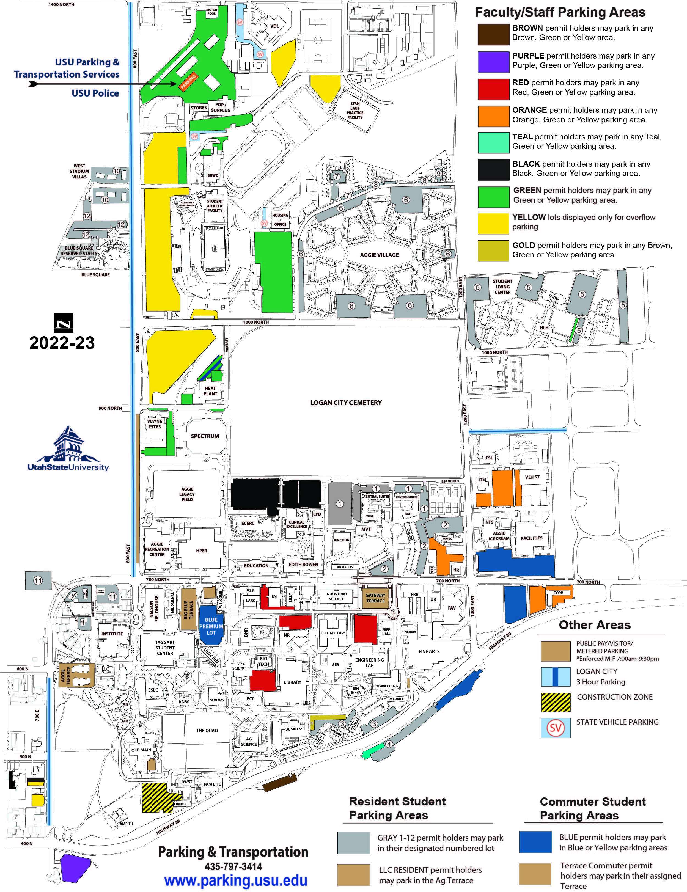
Proposed Campus Parking Assignments
Construction of Haravi Building
Completion of Central Suites
Completion of IT Building

Slide 8
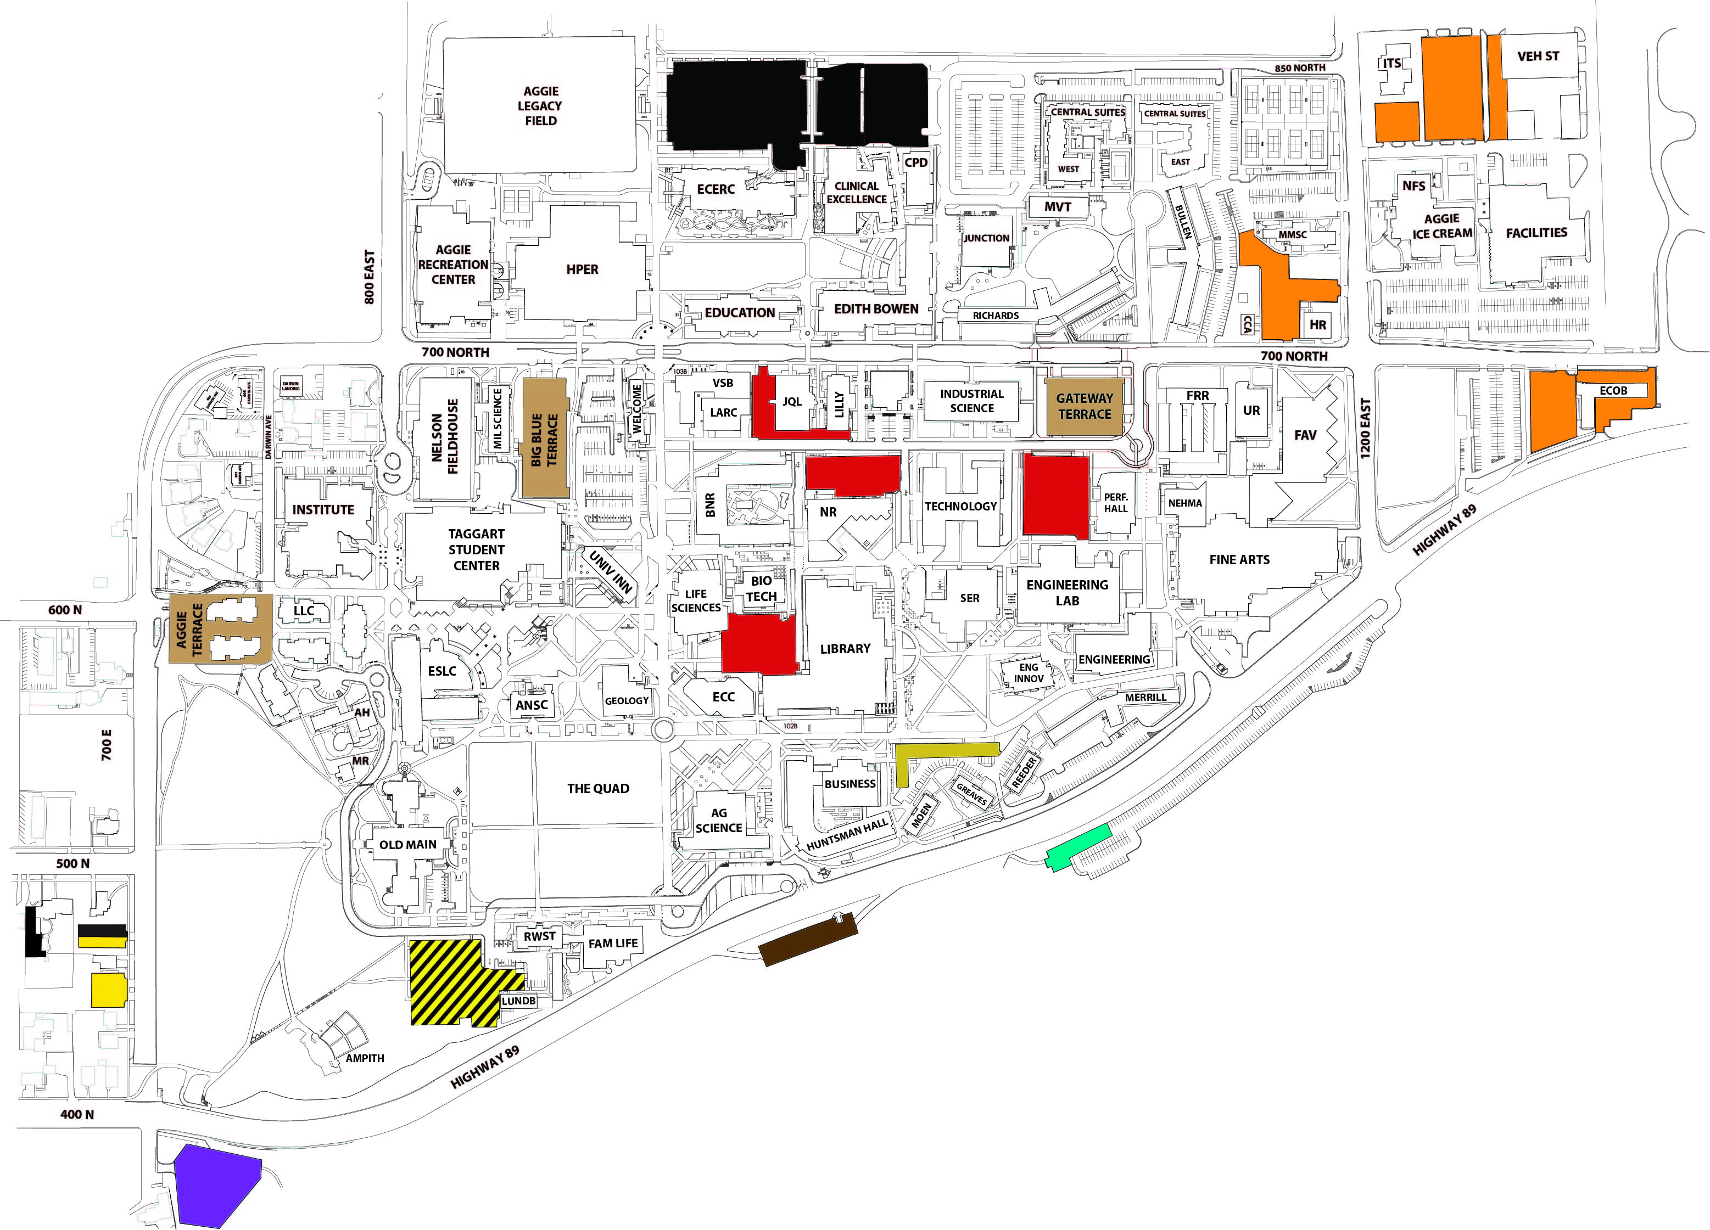
Faculty/Staff Proposed Parking Assignments

Slide 9
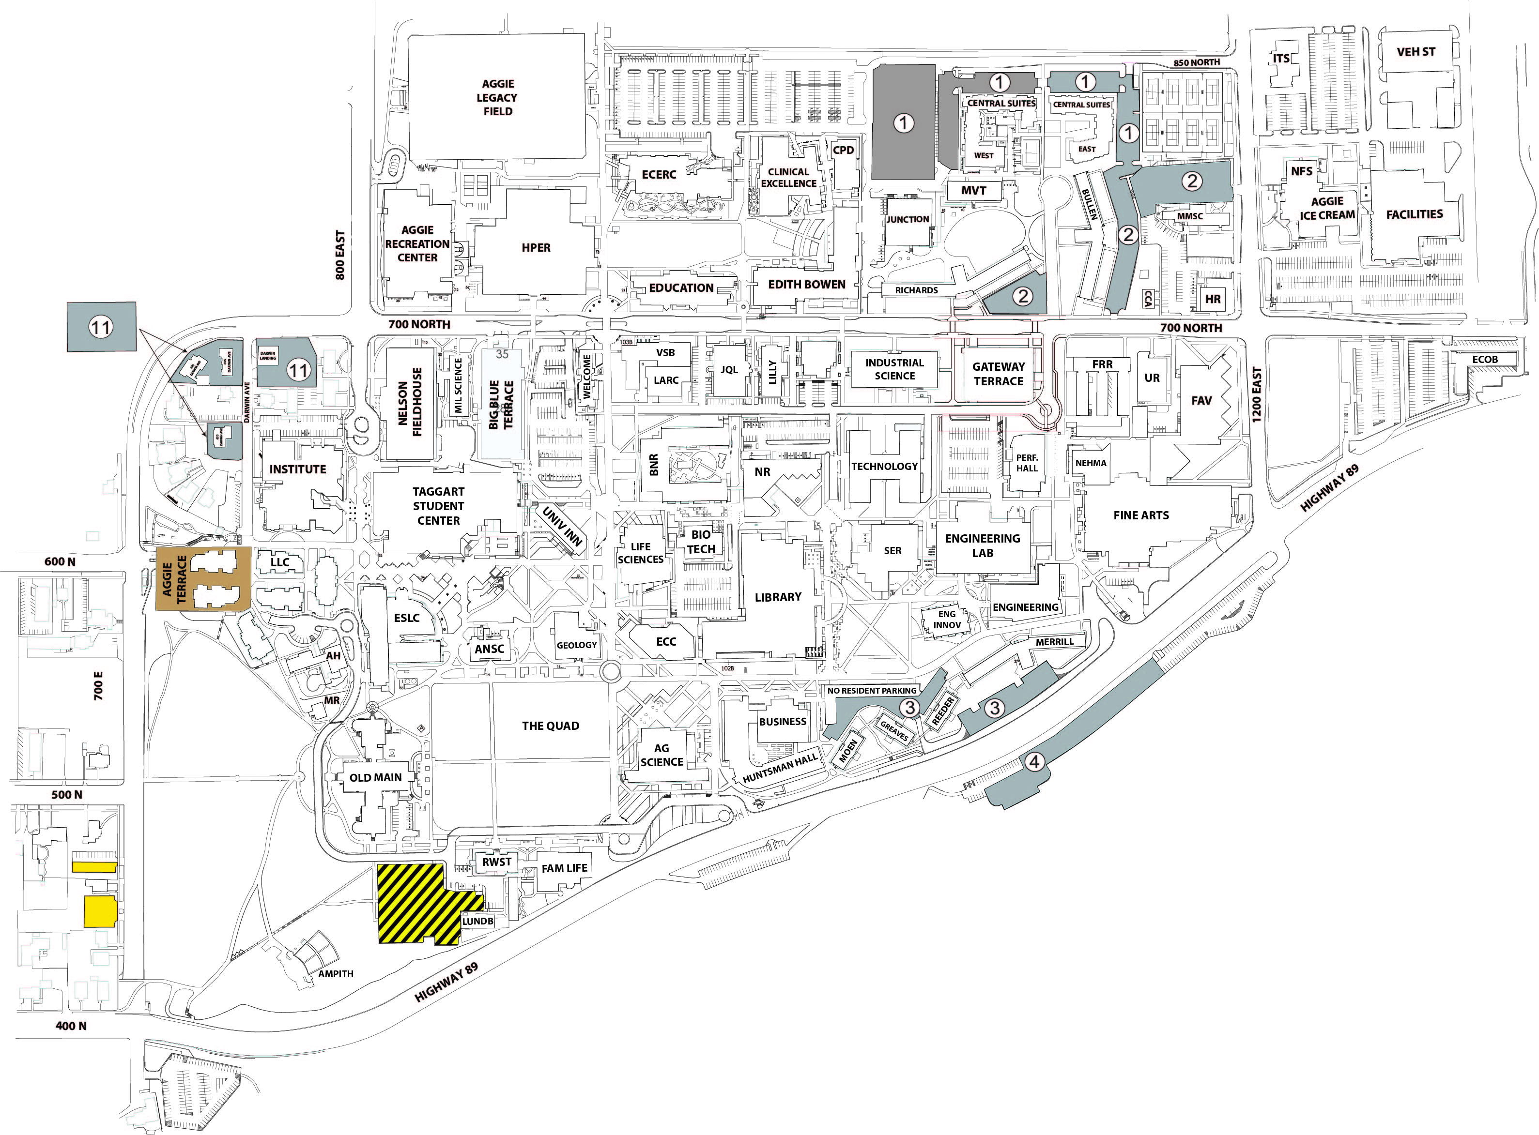
Proposed Resident Assignments

Slide 10
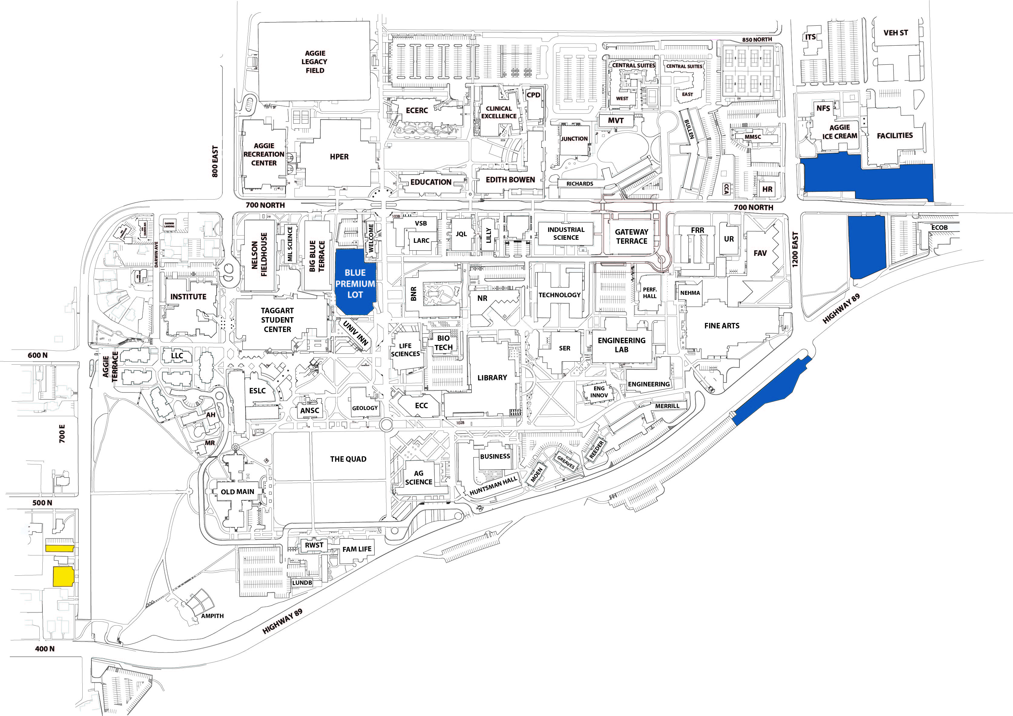
Proposed Commuter Assignments

Slide 11
Parking Permit Rate Table
Faculty/Staff Lots - effective March 1, 2022
 |  | Current Price | New Price | Annual Increase | Monthly Increase
Aggie Terrace |  | $320 | $330 | $10 | $0.83
Big Blue Terrace |  | $320 | $330 | $10 | $0.83
Gateway Terrace |  | $320 | $330 | $10 | $0.83
Purple |  | $235 | $245 | $10 | $0.83
Red |  | $235 | $245 | $10 | $0.83
Orange |  | $225 | $235 | $10 | $0.83
Brown & Gold |  | $235 | $245 | $10 | $0.83
Teal |  | $225 | $235 | $10 | $0.83
Black |  | $225 | $235 | $10 | $0.83
Green |  | $190 | $200 | $10 | $0.83
Student Lots - effective July 1, 2022
 |  | Current Price | New Price | Annual or Academic Increase | Monthly Increase
Blue |  | $190 | $200 | $10 | $0.83
Yellow |  | $99 | $109 | $10 | $0.83
GT/BBT/Aggie Terrace Com. |  | $305 | $315 | $10 | $1.11
Resident Lots - effective July 1, 2022
 |  | Current Price | New Price | Annual or Academic Increase | Monthly Increase
Aggie Terrace Resident |  | $260 | $270 | $10 | $1.11
Gray 1 Central Suites/VVT |  | $185 | $195 | $10 | $1.11
Gray 2 Richards/Bullen |  | $185 | $195 | $10 | $1.11
Gray 3 Merrill |  | $185 | $195 | $10 | $1.11
Gray 4 Highway |  | $170 | $180 | $10 | $1.11
Gray 5 SLC |  | $105 | $115 | $10 | $1.11
Gray 6 - 10 Aggie Village |  | $110 | $120 | $10 | $0.83
Gray 11 Darwin Ave |  | $185 | $195 | $10 | $0.83
Gray 12 Blue Square |  | $170 | $180 | $10 | $0.83
Blue Square Reserved |  | $225 | $235 | $10 | $0.83
Based on the current number of permits sold, the price increase will generate approximately $72,000 annually.

Slide 12
Past/Future Permit Projections Faculty/Staff lots
Faculty/Staff Lots | 2017 | 2018 | 2019 | 2020 | 2021 | New Pricing 2022 | 2023
Aggie Terrace | $273 | $285 | $295 | $310 | $320 | $330 | $340
Big Blue Terrace | $273 | $285 | $295 | $310 | $320 | $330 | $350
Gateway Terrace |  |  |  | $310 | $320 | $330 | $360
Brown/Gold | $190 | $200 | $210 | $225 | $235 | $245 | $255
Purple | $190 | $200 | $210 | $225 | $235 | $245 | $255
Red | $200 | $200 | $210 | $225 | $235 | $245 | $265
Orange | $166 | $180 | $195 | $210 | $225 | $235 | $245
Teal | $166 | $180 | $195 | $210 | $225 | $235 | $245
Black | $166 | $180 | $195 | $210 | $225 | $235 | $245
Green | $140 | $154 | $166 | $180 | $190 | $200 | $210
Electric Vehicle (EV) | $220 | $220 | $235 | $240 | $250 | $260 | $270

Slide 13
Permit Pricing Trends
Student Lots | 2017 | 2018 | 2019 | 2020 | 2021 | New Pricing 2022 | 2023
Blue | $135 | $150 | $165 | $180 | $190 | $200 | $200
Yellow | $55 | $66 | $78 | $89 | $99 | $110 | $110
AT/BBT Commuter | $248 | $265 | $283 | $295 | $305 | $318 | $318
Resident Lots - | 2017 | 2018 | 2019 | 2020 | 2021 | New Pricing 2022 | 2023
AT Resident | $216 | $228 | $240 | $250 | $260 | $270 | $280
Gray 1 Central Suites | $130 | $148 | $164 | $175 | $185 | $195 | $195
Gray 2 Rich/Bullen | $130 | $148 | $164 | $175 | $185 | $195 | $195
Gray 3 Merrill | $130 | $148 | $164 | $175 | $185 | $195 | $195
Gray 4 Highway | $118 | $135 | $149 | $160 | $170 | $180 | $180
Gray 5 | $71 | $81 | $90 | $95 | $105 | $115 | $115
Gray 6 - 10 | $71 | $81 | $90 | $100 | $110 | $120 | $120
Gray 11 Darwin | $130 | $148 | $164 | $175 | $185 | $195 | $195
Gray 12 Blue Square | $130 | $140 | $150 | $160 | $170 | $180 | $180
Blue Square Res | $220 | $220 | $220 | $220 | $225 | $230 | $230

Slide 14
Resolution 22-01
WHEREAS, The Parking and Transportation Department is an Auxiliary Enterprise, defined by
the Board of Regents Policy R550.3.1. The department must be self-supporting, which means receiving revenues (fees for service, sales, dedicated general fee, contributions, and investment income) must cover all or most of the direct and indirect operating expenses, assignable indirect costs, debt services, and capital expenditures (Board of Regents Policy R550.3.2); and
WHEREAS, University capital maintenance funding is not sufficient to meet the needs of all parking lot maintenance; and
WHEREAS, Since 2012, parking permit rates have adjusted for certain permits ranging from $0 to $20 per year ($2.22 per month); and
WHEREAS, Several projects have been identified with start dates within the next year; resurfacing of parking lots on campus and the financial impact of a new parking structure; and
WHEREAS, In order to render adequate services, auxiliary enterprises must have funds sufficient to meet current and future capital maintenance needs (Board of Regents Policy R550.6.2); and
WHEREAS, To plan for future parking structures and ongoing maintenance of surface lots currently used, the Parking and Transportation Department proposes to increase parking permit rates as shown on the attached table;
NOW THEREFORE BE IT RESOLVED BY THE PARKING AND TRANSPORTATION ADVISORY COMMITTEE, That the parking permit rate increase recommendations be established in order to cover the cost of maintenance, future growth, and development of parking lots or structures.

Slide 15
Parking Revenue Sources
Parking Permit Sales | $1,760,525
Terrace Sales / Blue Premium | $456,131
Fines | $115,929
Dedicated Stalls | $81,752
Meter Revenue | $82,350
Athletics/Events | $80,900
Total | $2,577,587

Slide 16
Parking Expenses
Department Labor | $618,489
Bond Payment - Aggie Terrace | $546,498
Bond payment - Gateway Terrace | $566,250
Administrative Fees | $99,929
Parking Lot Improvements | $45,900
Snow Removal | $57,442
IT/Telephone/Network Systems/Cameras | $116,484
Operating Expenses | $380,739
Total | $2,431,731

Slide 17
2022 Priority Capital Projects
Aggie Terrace Fire Suppression Upgrade 140,00
Improve Yellow Aggie Village East Parking Lot
Potential Parking Lot Resurfacing Projects:
Spectrum Green - $250,000
Aggie Village Laundry - $75,000
Old Main East - $50,000
Darwin Avenue - $75,000

Slide 18
Peer Institutions Parking Rate Comparison

Slide 19
Questions?

